Slide 1












Leveraging machine learning for Data Loss Prevention
24-25J-003

Slide 2









TEAM MEMBERS
Supervisor: Mr. Amila Senarathne
Co-Supervisor : Mrs. Suranjini Silva
STUDENT NAME | STUDENT ID
K.D.S.P JAYAWICKRAMA | IT21170720
H.A.N NILAKSHANA | IT21175602
P.P. LIYANAGE | IT21184758
G.B.T.G INDRAJITH | IT21229220

Slide 3



INTRODUCTION
This Data Loss Prevention (DLP) tool that incorporates advanced security features to protect sensitive data. The tool uses Homomorphic Encryption to allow secure data processing and classification without decryption, ensuring privacy.
It also provides defenses against brute force attacks and blocks malicious URLs, enhancing system security. Additionally, the tool includes a Steganographic Detection Module to uncover hidden data within files, preventing data leaks. Finally, its machine learning-powered Attention-Seeking Mode assigns risk scores to suspicious activities, helping prioritize security responses effectively.

Slide 4


RESEARCH PROBLEM
RESEARCH QUESTION
How can a Data Loss Prevention (DLP) tool, integrating homomorphic encryption, brute force attack mitigation, steganographic detection, and machine learning-based threat scoring, be developed to ensure secure data processing and effective threat detection in diverse environments?

Slide 5
OBJECTIVES
Ensure Secure Data Processing: Implement homomorphic encryption to allow data classification and analysis without decrypting sensitive information.
Prioritize Threat Responses: Utilize machine learning to create an attention-seeking mode that assigns risk scores to suspicious activities, enabling efficient threat prioritization.
Prevent Unauthorized Access: Develop mechanisms to detect anonymity login & URL blocking and malicious URLs, enhancing endpoint security.
Detect Covert Data Leaks: Integrate a steganographic detection module to identify hidden data within files and prevent data exfiltration.

Slide 6









Overall system diagram
End Point Devices
Web Traffic
Email/Documents
DLP Tool
Attention-seeking mode with ML scoring
Homomorphic encryption
Anonymity Detection & URL blocking
Steganographic Detection
Alerts & Reports
Database/Logs

Slide 7



Neelaka Nilakshana
IT21175602
H.A.N Nilakshana
BSc (Hons) in information Technology Specializing in cyber security
Anonymity Detection & URL blocking and browser security
IT21175602 | 24-25J-003

Slide 8




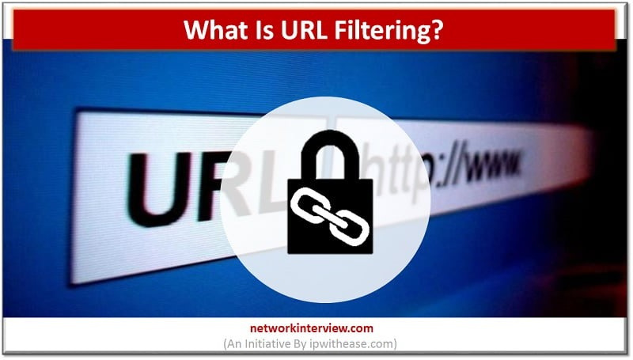

BACKGROUND
Cybersecurity threats, such as phishing and unauthorized logins, are growing rapidly. Malicious URLs, often used in phishing attacks, deceive users into revealing sensitive information, while abnormal login behaviors can signal potential security breaches. Traditional detection methods often struggle to keep up with evolving threats. Machine learning has emerged as a powerful tool to identify malicious URLs and detect login anomalies in real-time. Additionally, capturing unauthorized user photos during a breach provides valuable evidence for investigation. This research aims to develop a machine learning model that detects malicious URLs, monitors login anomalies, and captures unauthorized user photos to alert system administrators, improving response times and system security.
IT21175602 | 24-25J-003
Notes:
1.7.2013
Phishing is an attempt to steal sensitive information or break into organization's accounts. Phishing emails can also work by sending the victim an attachment that contains malware. When the victim opens the attachment, the malware is installed on their computer, and it can then steal their sensitive information or take control of their computer.
Why it’s important in DLP: phishing email detection is a critical aspect of DLP because it helps organizations protect sensitive data, maintain compliance, ensure business continuity, and safeguard their reputation. It complements other DLP measures by addressing a common and highly effective attack vector used by cybercriminals to compromise data security.
‹#›

Slide 9

RESEARCH QUESTION
How can machine learning be used to detect malicious URLs and anonymous login activities, while also capturing unauthorized user photos for enhanced security?
Machine learning algorithms can analyze patterns in URLs and login behaviors to identify malicious activity and anonymous. By incorporating facial recognition, unauthorized user photos can be captured during a breach, and alerts can be sent to system administrators in real time, improving both detection and response.
IT21175602 | 24-25J-003
Notes:
1.7.2013
Balancing False Positives and False Negatives:
False Positives: These occur when a legitimate email is incorrectly classified as a phishing email. False positives can lead to genuine communications being moved to spam folders, which can inconvenience users and potentially lead to missed opportunities.
False Negatives: These occur when a phishing email is incorrectly classified as a legitimate email. False negatives can lead to security breaches and data loss, as malicious emails go undetected.
‹#›

Slide 10



SPECIFIC AND SUB-OBJECTIVES
Specific Objective
To develop a machine learning-based system for detecting malicious URLs and anonymouslogin activities while capturing unauthorized user photos for enhanced security.
Sub Objective
Malicious URL Detection.
Anomalous Login Detection .
Unauthorized User Photo Capture.
System Alerting and Response
IT21175602 | 24-25J-003
Notes:
1.7.2013
Main Objective: The main objective of Phishing Email Detection in DLP system is to proactively identify and block phishing emails to prevent unauthorized access to sensitive data, reduce the risk of data breaches, and protect the organization's assets and reputation.
Sub-Objectives:
• Early Detection - Identify phishing emails as early as possible in the email delivery process to minimize the chances of user interaction with malicious content.
• Accurate Detection - Develop and implement advanced algorithms and techniques for accurate detection of phishing emails while minimizing false positives.
• Real-Time Monitoring: Continuously monitor incoming emails in real-time to detect and respond to phishing threats promptly.
‹#›

Slide 11

METHODOLOGY
Data Collection and Analysis
Implement URL Filtering Mechanism
Integration of Security Measures
Performance Evaluation
Real-World Testing
Documentation and Reporting
IT21175602 | 24-25J-003

Slide 12
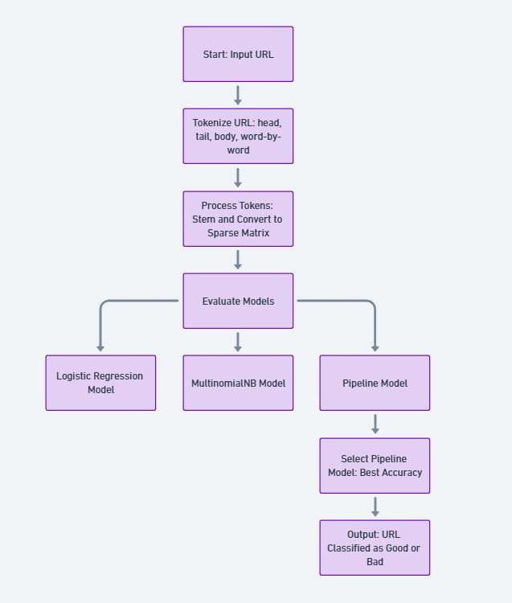
SYSTEM DIAGRAM
IT21175602 | 24-25J-003

Slide 13
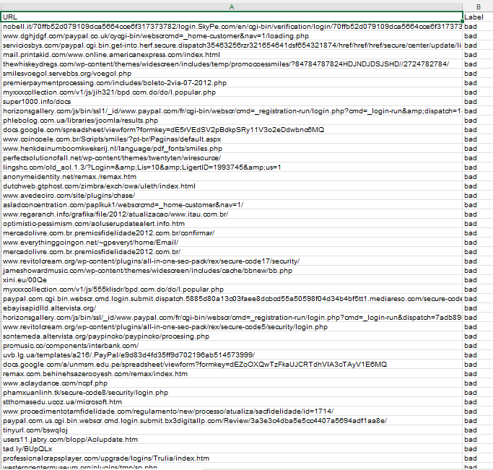
DATASET
Phishing URl Dataset
IT21175602 | 24-25J-003

Slide 14
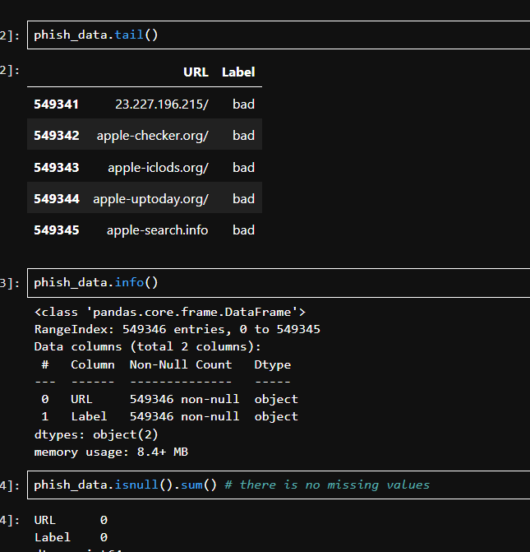
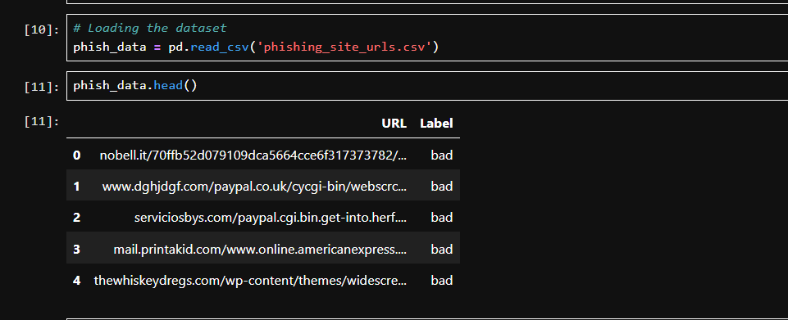
CODE
IT21175602 | 24-25J-003

Slide 15

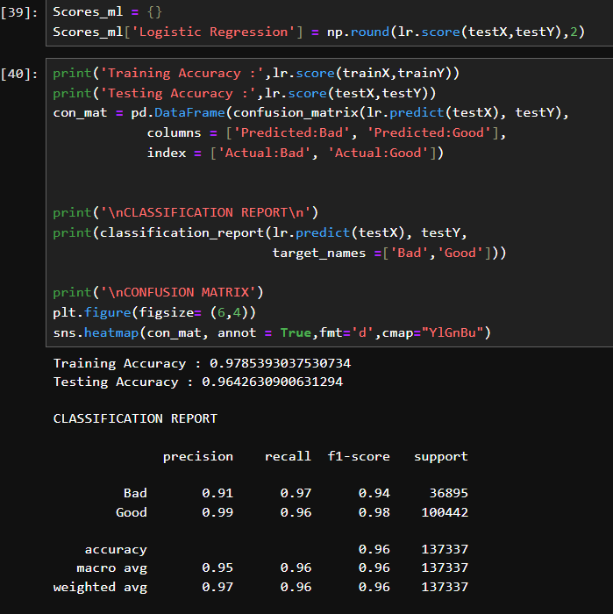
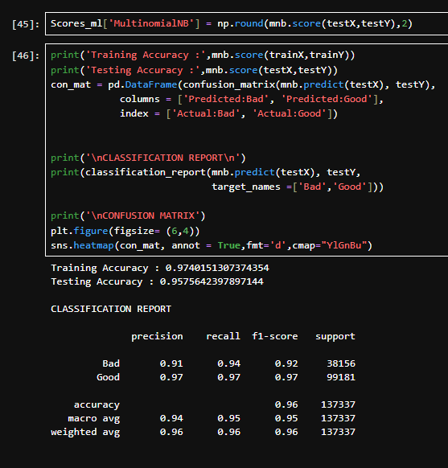
OUTCOMES
IT21175602 | 24-25J-003

Slide 16

DEMO
IT21175602 | 24-25J-003

Slide 17

REFERENCES
Orozco-Fonseca, D., Marín, G., & Lara, A. (2024). Taxonomy of malicious URL detection Techniques. In Lecture notes in networks and systems (pp. 73–81). https://doi.org/10.1007/978-3-031-54235-0_7
Mok, K. H., & Kyu, A. P. (2020). Web-based brute force attack blocking device and method using machine learning. SciSpace - Paper. https://typeset.io/papers/web-based-brute-force-attack-blocking-device-and-method-4uiuro3jv3
Nowroozi, E., Abhishek, N., Mohammadi, M., & Conti, M. (2022). An Adversarial attack analysis on Malicious Advertisement URL Detection Framework. IEEE Transactions on Network and Service Management, 20(2), 1332–1344. https://doi.org/10.1109/tnsm.2022.3225217
IT21175602 | 24-25J-003

Slide 18

Sulaksha Punsara
IT21170720
K.D.S.P Jayawickrama
BSc (Hons) in information Technology Specializing in cyber security
Homomorphic Encryption for Data Processing
IT21170720 | 24-25J-003

Slide 19

BACKGROUND
Homomorphic encryption enables secure data processing by allowing computations on encrypted data without decryption, addressing privacy concerns in various sensitive fields. However, it struggles with large files, necessitating a solution that combines data classification to effectively manage smaller, sensitive data. This integration enhances data security and ensures compliance with privacy regulations while facilitating secure analysis and processing of critical information.
IT21170720 | 24-25J-003
Notes:
Data Integrity: IoT edge devices often collect, process, and transmit valuable data. Injection attacks can manipulate the data generated by these devices, leading to incorrect decisions, actions, or analytics. Ensuring data integrity is essential for making reliable and informed decisions based on IoT data.
Device Control: Many IoT edge devices control physical systems and equipment. Injection attacks can give attackers unauthorized access and control over these devices, potentially leading to safety hazards, physical damage, or operational disruptions.
Privacy and Confidentiality: Injection attacks can compromise the privacy and confidentiality of sensitive data collected and processed by IoT edge devices. Unauthorized access to such data can lead to breaches of personal, financial, or proprietary information.
Network Security: IoT edge devices are often part of a larger IoT network. An injection attack on an edge device can serve as an entry point for attackers to compromise the entire IoT network. Once inside the network, attackers can target other devices and the central infrastructure, potentially causing widespread damage.
21

Slide 20
RESEARCH QUESTION
How can homomorphic encryption be integrated with data classification to ensure secure processing of sensitive data in a DLP tool?
Homomorphic encryption can be integrated with data classification in a DLP tool by first identifying and prioritizing sensitive, smaller data for encryption while segmenting larger files for alternative protection. This allows for secure computations on encrypted data without exposure, ensuring compliance and privacy. By implementing a centralized monitoring system, we can efficiently manage encrypted and non-encrypted data, enhancing overall data security.
IT21170720 | 24-25J-003

Slide 21

SPECIFIC AND SUB-OBJECTIVES
Specific Objective
The primary objective of the "Homomorphic Encryption for Data Processing" component is to enhance data security by enabling secure computations on sensitive data without the need for decryption. This involves implementing a robust data classification system that prioritizes and manages smaller, sensitive data sets effectively. The goal is to protect privacy while allowing effective data analysis within a Data Loss Prevention (DLP) tool, ensuring compliance with relevant regulations.
Sub Objective
Implement Data Classification
Ensure Efficient Data Processing
Integrate with DLP Tool
IT21170720 | 24-25J-003

Slide 22
METHODOLOGY
Data Classification Framework
Homomorphic Encryption Implementation
Integration with DLP Tool
Testing and Evaluation
IT21170720 | 24-25J-003

Slide 23
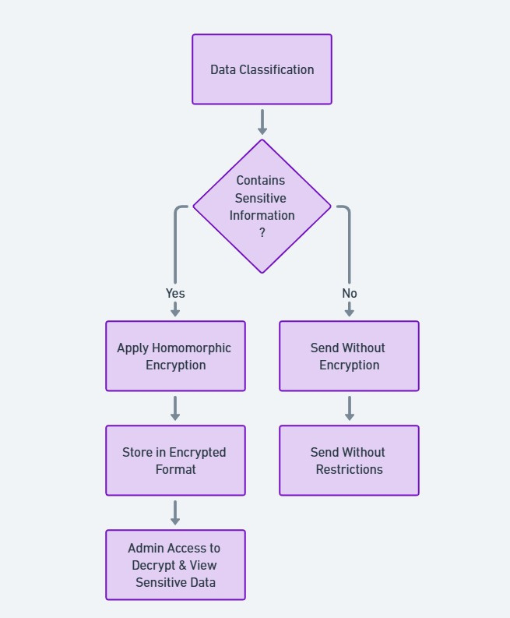

SYSTEM DIAGRAM
IT21170720 | 24-25J-003

Slide 24
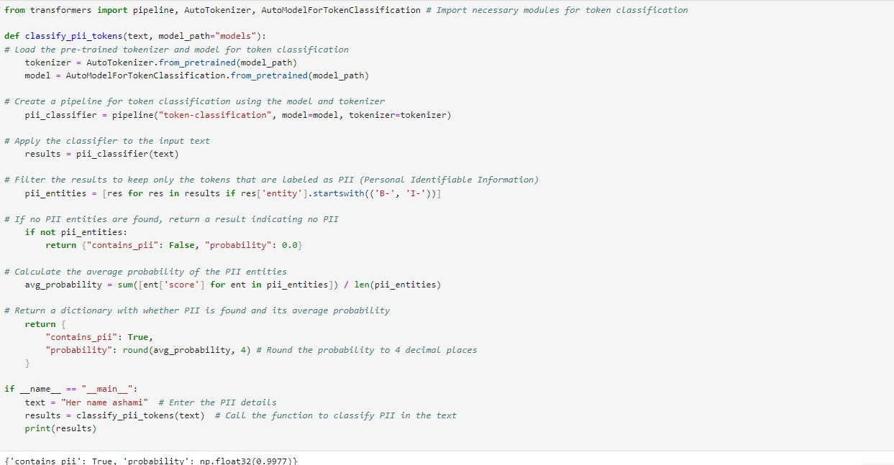
CODE
IT21170720 | 24-25J-003

Slide 25
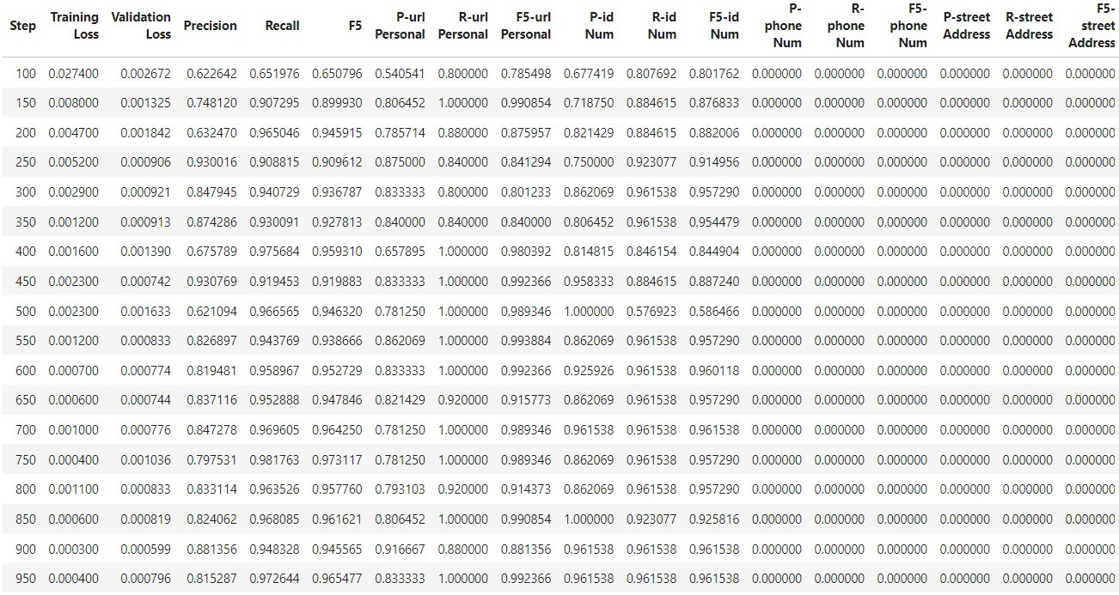
OUTCOME
IT21170720 | 24-25J-003

Slide 26
DEMO
IT21170720 | 24-25J-003

Slide 27
REFERENCES
A. Gupta, "Data Loss Prevention," in *IEEE Computer Society Data*, 2009. [Online]. Available: https://www.researchgate.net/publication/224127741_Data_Loss_Prevention. [Accessed: Oct. 23, 2024].
J. Smith and K. Patel, "Cybersecurity Technology Strategic Plan for Data Loss Prevention," in *Proceedings of the International Conference on Cybersecurity Strategies*, 2023. [Online]. Available: https://www.researchgate.net/publication/377822490_Cybersecurity_Technology_Strategic_Plan_for_Data_Loss_Prevention. [Accessed: Oct. 23, 2024].
M. Brown and R. Jones, "A Survey on Balancing Data Loss Prevention (DLP) with User Privacy in a Data-Driven World," in *Journal of Information Security*, 2024. [Online]. Available: https://www.researchgate.net/publication/383187137_A_Survey_on_Balancing_Data_Loss_Prevention_DLP_with_User_Privacy_in_a_Data-Driven_World. [Accessed: Oct. 23, 2024].
IT21170720 | 24-25J-003

Slide 28

Tharindu Gihan
IT21229220
G.B.T.G Indrajith
BSc (Hons) in information Technology Specializing in cyber security
Stego Images Detection
IT21229220 | 24-25J-003

Slide 29
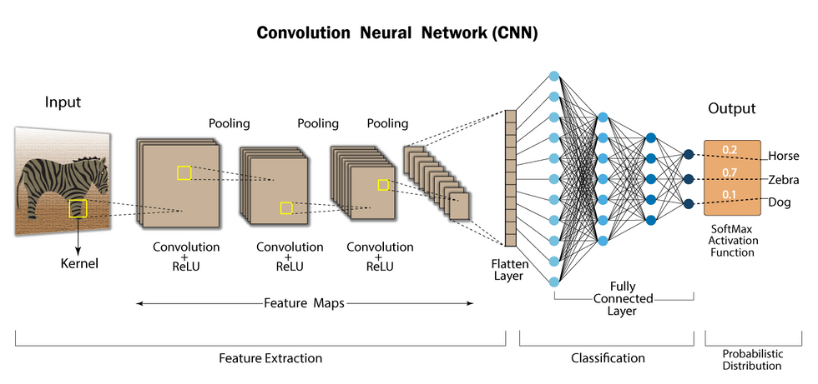

BACKGROUND
What is steganalysis?
The process of detecting hidden messages embedded in digital files like images or videos.
How do Dual-CNN Models Help in Steganalysis?
They analyze images at fine and coarse scales, improving detection accuracy through feature fusion.
Why is Real-Time Detection Important?
It blocks hidden data transfers immediately, preventing data leaks.
What is Spatial vs. Frequency Domain Steganography?
Spatial: Hides data by altering pixel values (e.g., LSB).
Frequency: Hides data by modifying frequency components (e.g., DCT).
IT21229220 | 24-25J-003

Slide 30
RESEARCH QUESTION
How can dual-CNN models with feature fusion be utilized to enhance the detection of steganographic content within a Data Loss Prevention (DLP) tool?
This research question focuses on exploring how the integration of two CNN models operating at fine and coarse scales, along with feature fusion, can improve the accuracy and efficiency of steganalysis. It aims to address real-time detection challenges, reduce false positives, and enhance the overall effectiveness of DLP systems in preventing data exfiltration through hidden content in images.
IT21229220 | 24-25J-003

Slide 31

SPECIFIC AND SUB-OBJECTIVES
Specific Objective
To enhance the accuracy of steganographic content detection by developing a dual-CNN feature fusion model and integrating it within a Data Loss Prevention (DLP) tool for real-time threat prevention.
Sub Objective
Design and Train Spatial Domain and Frequency Domain CNN Models
Implement Feature Fusion Mechanism
Develop Real-Time Detection Capabilities
Create Automated Alerting and Reporting System
Deploy User-Friendly Dashboard for Visualization
IT21229220 | 24-25J-003

Slide 32
METHODOLOGY
Dataset Selection and Preprocessing
Development of Dual-CNN Models
Algorithm Implementation and Testing
Integration with DLP System
Performance Evaluation and Optimization
IT21229220 | 24-25J-003

Slide 33
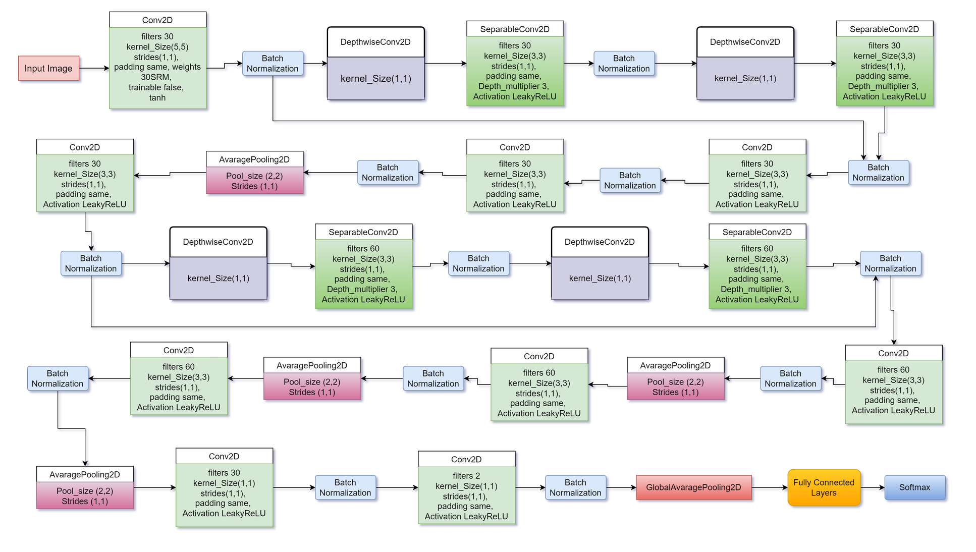
SYSTEM DIAGRAM
IT21229220 | 24-25J-003

Slide 34
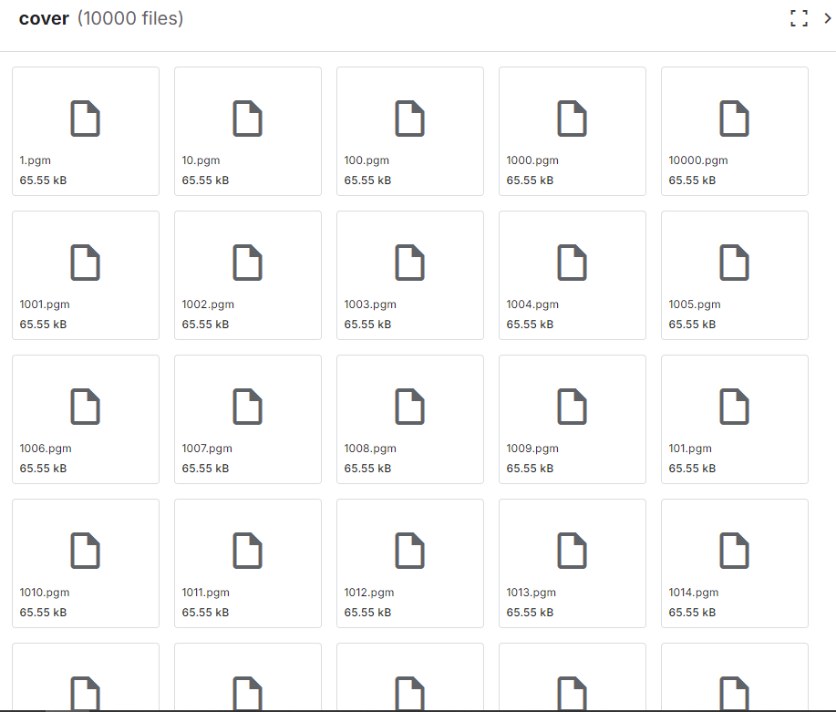

DATASET
IT21229220 | 24-25J-003

Slide 35
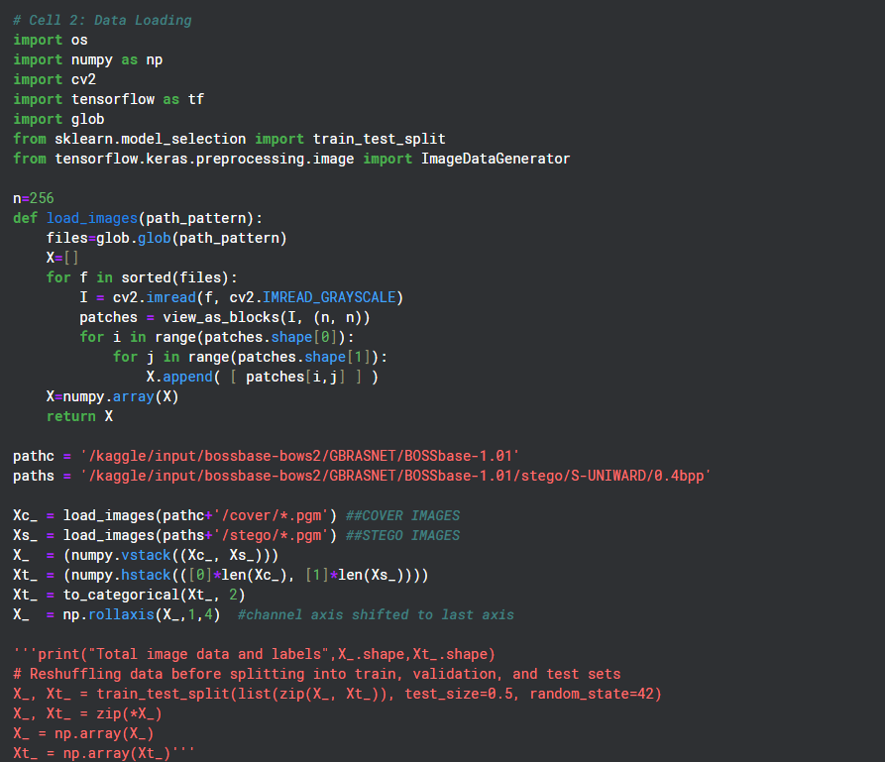
CODE
IT21229220 | 24-25J-003

Slide 36
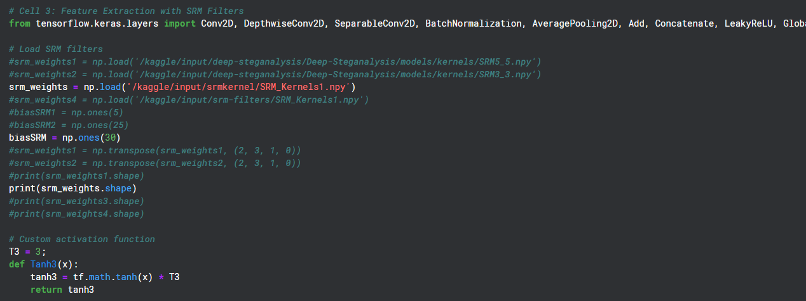
CODE
IT21229220 | 24-25J-003

Slide 37
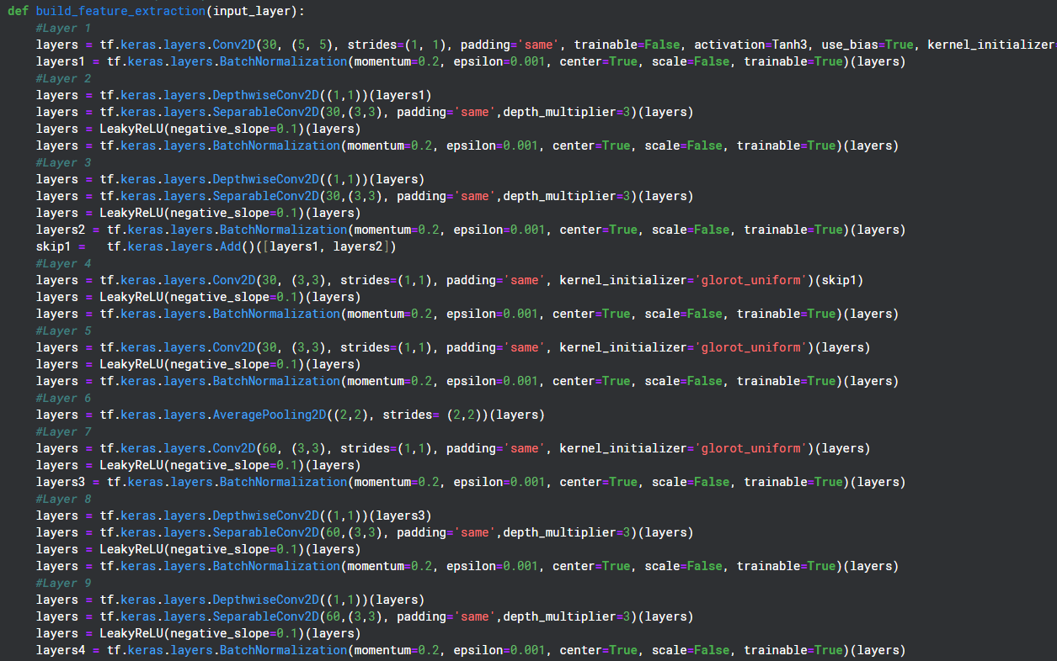
CODE
IT21229220 | 24-25J-003

Slide 38
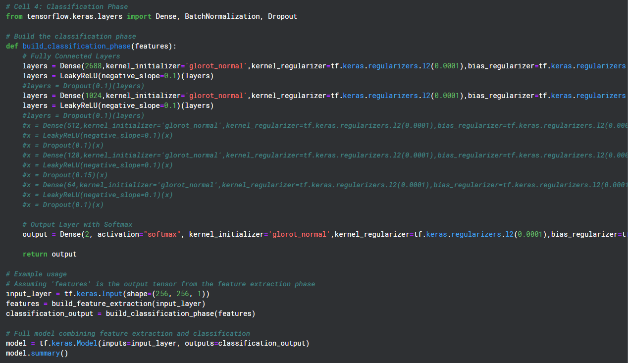
CODE
IT21229220 | 24-25J-003

Slide 39
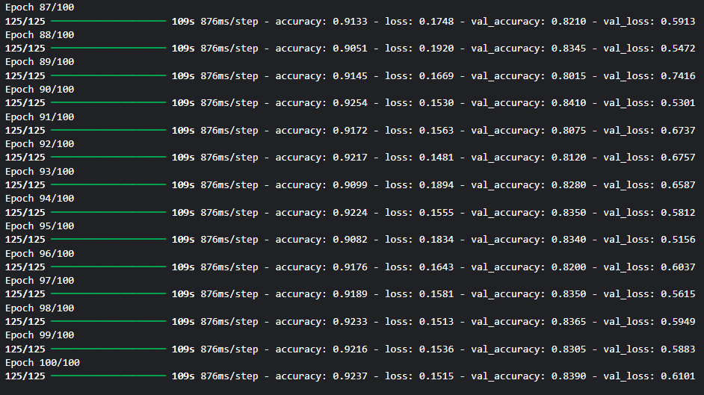
CODE
IT21229220 | 24-25J-003

Slide 40
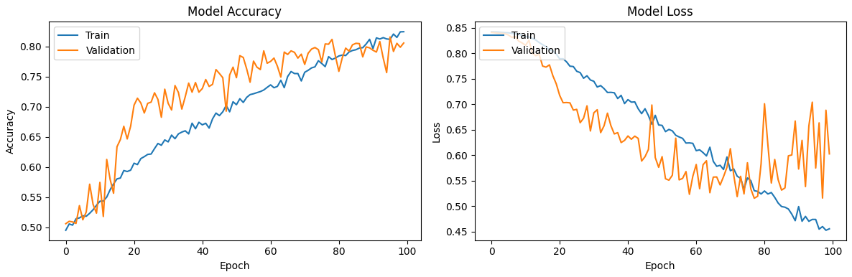
OUTCOME
IT21229220 | 24-25J-003

Slide 41
DEMO
IT21229220 | 24-25J-003

Slide 42
REFERENCES
[1] Progonov, D. (2023b). Destruction of stego images formed by adaptive embedding methods with dictionary learning methods. Theoretical and Applied Cybersecurity, 4(1). https://doi.org/10.20535/tacs.2664-29132022.1.254883
[2] De La Croix, N. J., & Ahmad, T. (2023a). Toward secret data location via fuzzy logic and convolutional neural network. Egyptian Informatics Journal, 24(3), 100385. https://doi.org/10.1016/j.eij.2023.05.010
[3] Hidayasari, N., Riadi, I., & Prayudi, Y. (2020b). Steganalysis Using Yedrodj-net net’s Convolutional Neural Networks (CNN) Method on Steganography Tools. Proceeding International Conference on Science and Engineering, 3, 207–211. https://doi.org/10.14421/icse.v3.499
IT21229220 | 24-25J-003

Slide 43

Pubudu Liyanage
IT21184758
P.P Liyanage
BSc (Hons) in information Technology Specializing in cyber security
Attention-Seeking Mode with a Score System Using Machine Learning
IT21184758 | 24-25J-003

Slide 44

BACKGROUND
Introduction:
In modern cybersecurity environments, Data Loss Prevention (DLP) systems are critical for detecting and preventing potential data breaches. However, these systems often generate a high volume of alerts, presenting challenges for security teams.
Importance:
High Alert Volumes: DLP systems often trigger numerous alerts daily, many of which are low priority.
Alert Fatigue: Security teams struggle to manage and prioritize alerts, leading to missed or delayed responses to critical threats.
Efficiency Challenge: There is a growing need for intelligent systems that can prioritize alerts, reducing the cognitive load on analysts and improving incident response times.
IT21184758 | 24-25J-003

Slide 45
RESEARCH QUESTION
How can machine learning be leveraged to implement an attention-seeking mode that intelligently prioritizes DLP security alerts based on their potential risk?
"Machine learning can be applied to DLP systems by analyzing historical incident data and assigning risk scores to alerts. This enables the system to prioritize high-risk alerts, reducing alert fatigue and allowing security teams to respond more effectively to critical threats."
IT21184758 | 24-25J-003

Slide 46

SPECIFIC AND SUB-OBJECTIVES
Specific Objective
Develop a machine learning-based system to prioritize security alerts based on their risk scores.
Sub Objective
Develop an ML-based system to detect and classify sensitive information from security alerts.
Assign risk scores to alerts based on severity and potential impact using historical incident data.
Evaluate the system’s effectiveness in reducing alert fatigue and enhancing response prioritization.
IT21184758 | 24-25J-003

Slide 47
METHODOLOGY
Data Collection: Gather historical incident and alert data from DLP systems to serve as the foundation for model training and validation.
Feature Engineering: Identify and extract critical factors that contribute to alert risk, such as frequency, context, and historical impact.
Modeling: Implement machine learning algorithms to assign dynamic risk scores to alerts, prioritizing those with higher potential impact.
Testing: Evaluate the model using real-world or simulated alert data to ensure practical applicability and reliability.
Optimization: Fine-tune the model iteratively based on performance metrics and feedback from testing results.
IT21184758 | 24-25J-003

Slide 48
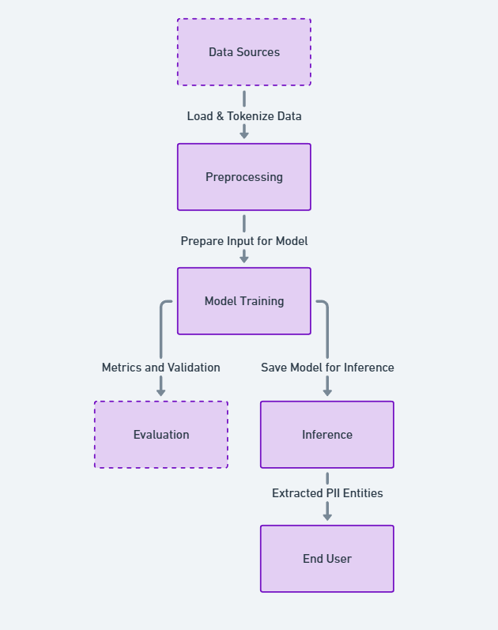
SYSTEM DIAGRAM
IT21184758 | 24-25J-003

Slide 49
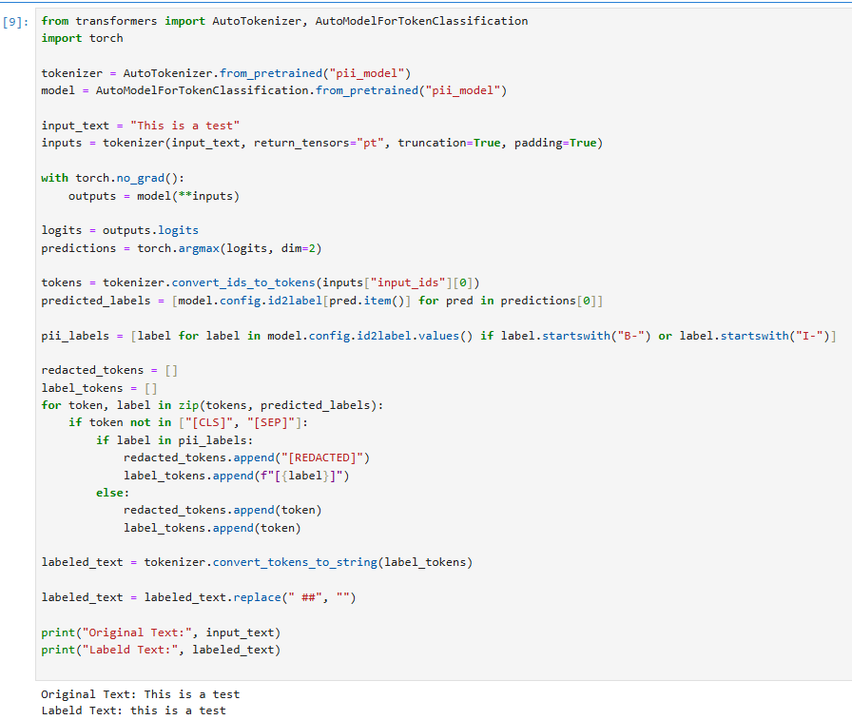
CODE
IT21184758 | 24-25J-003

Slide 50
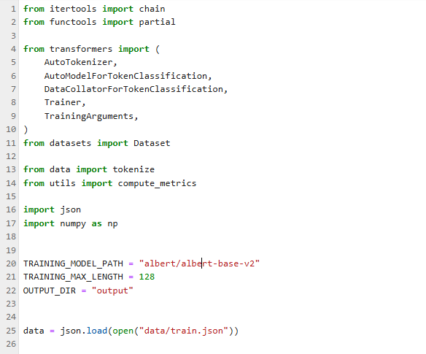
CODE
IT21184758 | 24-25J-003

Slide 51
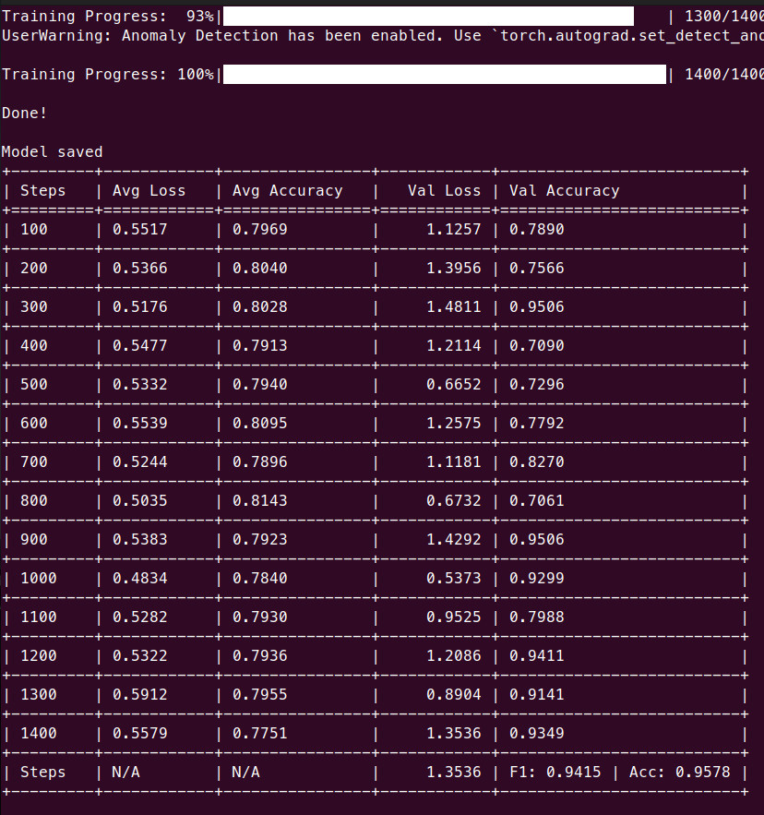
OUTCOME
IT21184758 | 24-25J-003

Slide 52
DEMO
IT21184758 | 24-25J-003

Slide 53
REFERENCES
O. Keskin, N. Gannon, B. Lopez and U. Tatar, "Scoring Cyber Vulnerabilities based on Their Impact on Organizational Goals," 2021 Systems and Information Engineering Design Symposium (SIEDS), Charlottesville, VA, USA, 2021, pp. 1-6, doi: 10.1109/SIEDS52267.2021.9483741.
E. Seker and W. Meng, "XVRS: Extended Vulnerability Risk Scoring based on Threat Intelligence," 2023 IEEE International Conference on Metaverse Computing, Networking and Applications (MetaCom), Kyoto, Japan, 2023, pp. 516-523, doi: 10.1109/MetaCom57706.2023.00094.
M. Keramati, "New Vulnerability Scoring System for dynamic security evaluation," 2016 8th International Symposium on Telecommunications (IST), Tehran, Iran, 2016, pp. 746-751, doi: 10.1109/ISTEL.2016.7881922.
IT21184758 | 24-25J-003

Slide 54


Slide 55










Thank You

